Slide 1
Aprisa SR
Product options

Slide 2
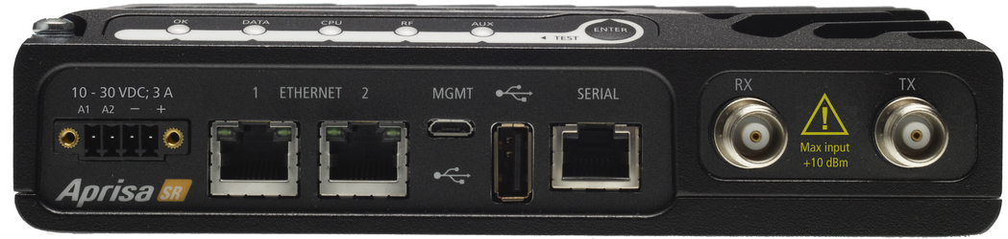
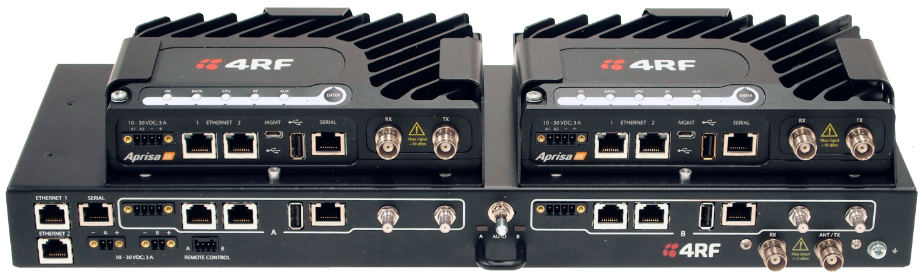
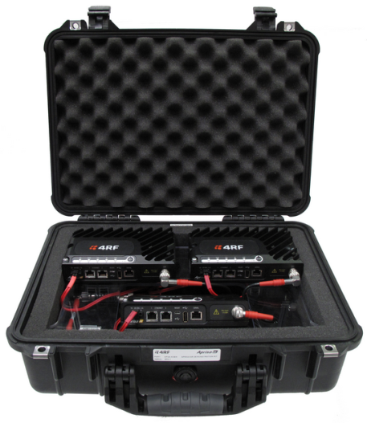
Aprisa SR product options
The Aprisa SR provides a number of different product options for maximum flexibility:
  Frequency bands
  Channel bandwidths
  Redundant solution
  Single and dual antenna port options
A three radio demonstration kit is also available for easy product evaluation.
In large systems the Aprisa SR interoperates seamlessly with the Aprisa XE point-to-point microwave link.

Slide 3
Frequency band and channel bandwidth options
Frequency band options:
  VHF: 136 – 174 MHz
  UHF: 400 – 470 MHz
For each band, the Aprisa SR provides full RF band coverage without any need for tuning.
Channel bandwidth options:
  12.5 kHz, providing 9.6 kbit/s
  25 kHz, providing 19.2 kbit/s
Frequency bands and channel bandwidths require coordination with the frequency regulatory authority in the country of use.
4RF provides the ChannelScape planning tool to assess capacity requirements based on SCADA applications.
 | 12.5 kHz | 25 kHz
VHF | ✔ | ✔
UHF | ✔ | ✔

Slide 4

Option: dual antenna port
At many of today’s crowded base station sites, shared with broadcast and LMR transmitters, signal levels are so strong and so closely spaced that additional filtering is needed. While the RF performance of the Aprisa SR mitigates overload and intermodulation, a dual port antenna option is available for the worse cases. The dual antenna port option provides separate transmit and receive antenna connections, to support the fitting of external duplexers or filters. While most often used at busy base station sites, repeaters and remote stations can also use this functionality if required.
Notes:
The transmission remains half duplex

Slide 5
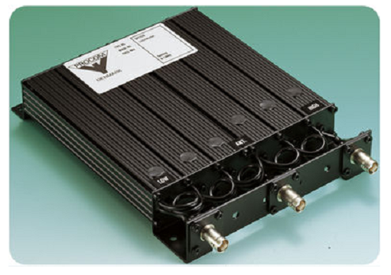
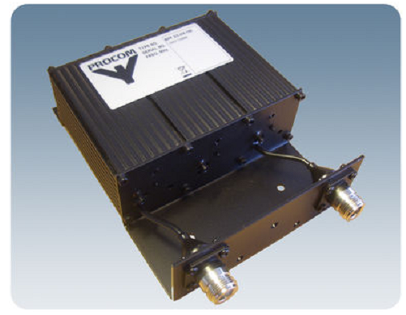
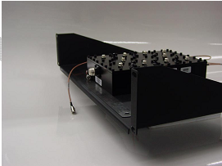
Option: duplexers for the dual antenna port option
4RF can provide the duplexers required for the dual antenna option. These external filters are often required at base station sites or remote sites that are shared with other services, depending on antenna placement and separation between services. The duplexer option provides separate transmit and receive filters connected to a common antenna port.
Notes:
Accessories – VHF duplexer and filters: For VHF 4RF offers a Procom DPF 2/6 duplexer combined with a Procom BPF 2/3 band pass receive filter. These are often required at base station sites or remote sites that are shared with other VHF services, depending on antenna placement and separation between services.

Slide 6
Option: redundant solution
The Aprisa SR Protected Station comprises two standard radios and a Protection Switch:
  Full radio and user interface protection when configured as a base station – repeater and remote station configuration is available in Q312
  RF and interface ports are switched to the standby radio if there is a failure in the active radio
  Two DC power connections support redundant power supplies
  Available in all Aprisa SR frequency bands and channel sizes for both single and dual antenna port options

Slide 7
Aprisa SR Protected Station operation and configuration
The Aprisa SR Protected Station will switch from the active to the standby radio:
  When any of the configurable alarm events occur
  If there is a loss of ‘keep alive’ signal from the active unit
SuperVisor is used to configure the Protected Station options:
  It is possible to customise which alarm events will trigger the switchover
  It is also possible to create blocking criteria that select which alarms prevent the switchover if present in the standby radio
Other Protection Station functionality includes:
  Switch over will not occur if there is a power failure or an active alarm event is detected on the standby unit
  To prevent protection switch oscillation a switchover will not occur until 20 seconds after the previous switchover
Customisable trigger alarms
PA current
Tx AGC
Tx reverse power
Temperature threshold
Thermal shutdown
RSSI threshold
Rx CRC errors
RF no receive data
Eth port 1 – no receive data
Eth port 1 – data receive errors
Eth port 1 – data transmit errors
Eth port 2 – no receive data
Eth port 2 – data receive errors
Eth port 2 – data transmit errors
Serial port – no receive data
Serial port – data receive errors
Component failure
Calibration failure
Configuration not supported
Notes:
PA current
Tx AGC
Tx reverse power
Temperature threshold
Thermal shutdown
RSSI threshold
Rx CRC errors RF no receive data
Ethernet port 1 – no receive data
Ethernet port 1 – data receive
Ethernet port 1 - data transmit errors
Ethernet port 2 – no receive data
Ethernet port 2 – data receive errors
Ethernet port 2 - data transmit
Serial port – no receive data
Serial port – data receive error
Component failure
Calibration failure
Configuration not supported

Slide 8
Aprisa SR Protected Station FAQs
FAQ | Protected Station
Q. | What size is it?
A. | 19 inch, 2U unit
Q. | How does switch over occur?
A. | Switch over can be initiated automatically on fault detection (customer configurable) or manually via the toggle switch on the Protection Switch. The Protected Station can also be switched remotely via the remote control connector on the front of the Protection Switch, enabling the end user to change the operating radio from active to standby without visiting the base station site.
Q. | What is the switch over time?
A. | On detection of an alarm fault the switch over time is less than five seconds and the radio boot up time is approximately eight seconds.

Slide 9

Demonstration kit
The Aprisa SR demonstration kit provides a base station and two remote units, in a rugged, transportable case.
It includes a power supply and establishes a radio path using cables, attenuators, and an RF splitter.
It is used to show the features and functionality of the Aprisa SR in a point-to-multipoint topology, with serial and Ethernet connectivity, and full element and network management functions.
Designed for sales team and distribution partner use, it is also a quick and easy way for customers to evaluate the performance and management of the Aprisa SR.

Slide 10
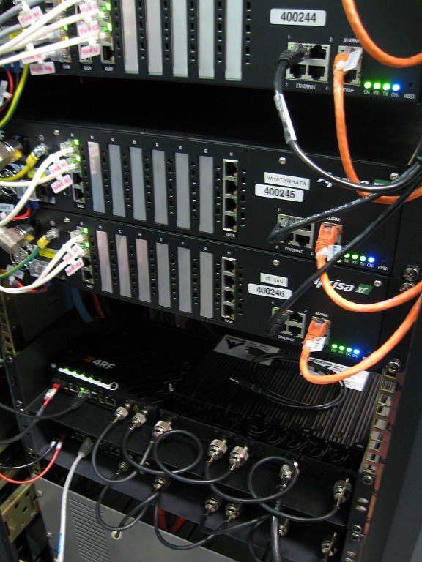
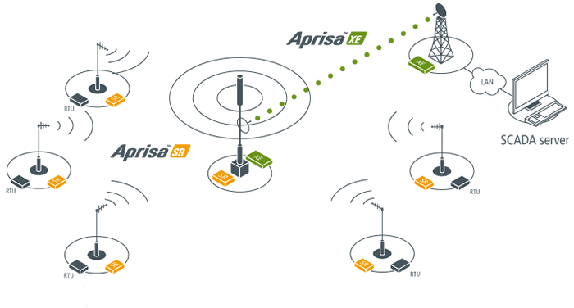


Integration with Aprisa XE
The Aprisa SR integrates seamlessly with the Aprisa XE point-to-point link for network backhaul or individual long distance monitoring links. The Aprisa XE is available in a range of frequency bands from 330 MHz up to 2.7 GHz.

