Slide 1
Aprisa SR
Security

Slide 2
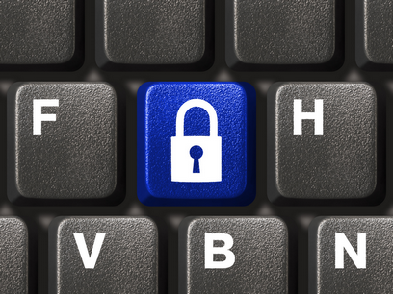
Aprisa SR security
Cyber security is a key issue today, and rarely out of the headlines. SCADA radio needs to be secure, and the 360 degree approach to security that the Aprisa SR incorporates is a key differentiator in the marketplace. Security is designed into the product from the start:
  Taking account of the key considerations of integrity, availability, confidentiality and
  non-repudiation
  Building on industry best practice and standards
  With security features throughout the interfaces, operating system and management
Security extends to site security, where the
Aprisa SR also has a role to play.

Slide 3
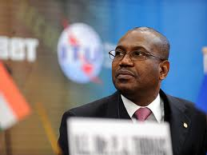

Security in the headlines
  ITU secretary general Dr Hamadoun Touré has called for an international cyberwar peace treaty - Jan 2010.
“I do not rule out the prospect of an aggressive act of such a scale which deliberately targets the networks that are the nervous system of the country's critical infrastructure - that is, the energy grid, our water supplies”
March 11 2010, Rt Hon Baroness Pauline Neville-Jones, ex UK Minister of State for Security and Counter-Terrorism.

Slide 4
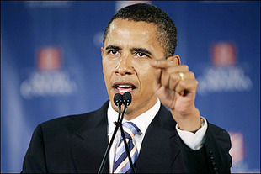
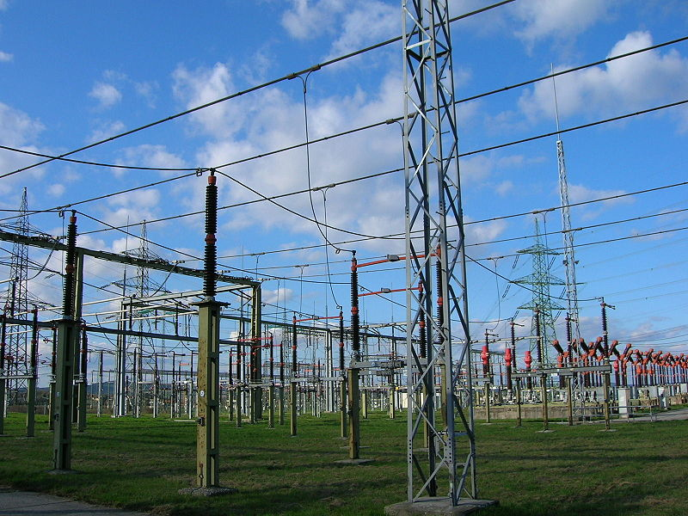
Cyber terrorism
The cyber threat to “the massive grids that power our nation ... is one of the most serious economic and national security challenges we face as a nation“.
President Obama - May 29 2009.
In this context, cyber terrorism is the use of the Internet to make terrorist deliberate attacks against information systems affecting real world infrastructure, property, or lives. Real threats exist from disgruntled
ex-employees, those who ‘hack for fun’, radical greens, terrorists, and state sponsored entities.

Slide 5
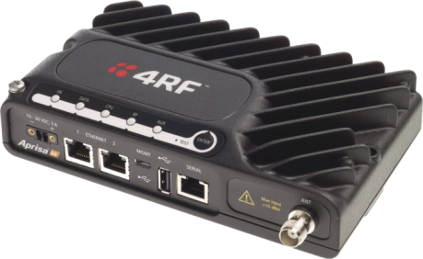
What is meant by the 360 degree approach to security?
What is 360 degree security?
  Over the air protection
  Protected management interfaces
  Secure USB software upgrades
  Micro-firewalling Ethernet interface
  Using government standards and best practice
This approach means securing the perimeter around Aprisa SR and the design environment of the product – all external ports must be considered:
  Antenna
  Ethernet
  Serial
  USB
  360 degree security – a SCADA revolution.
Ethernet
Ethernet
USB
Serial
Wireless
Wireless
Management
Data
“The price of peace is eternal vigilance”, Leonard Courtney, 1st Baron Courtney

Slide 6
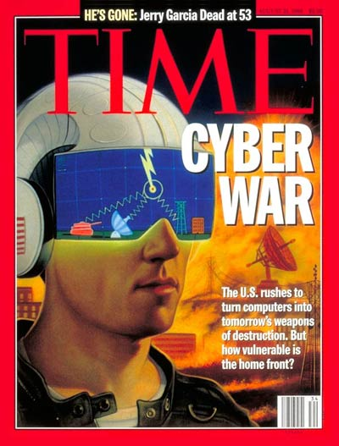

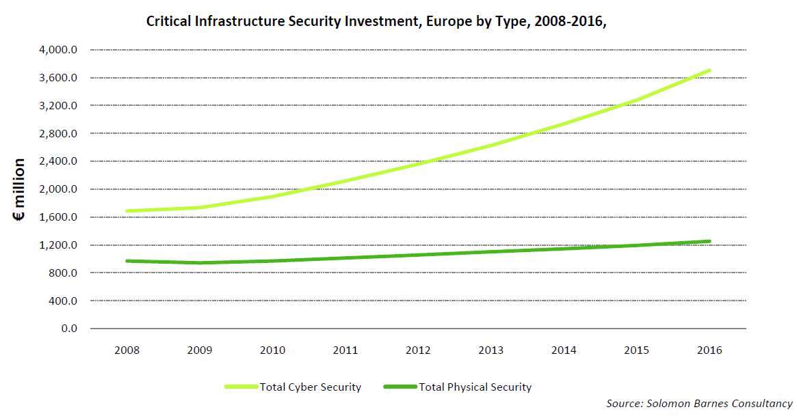
SCADA radio needs to be secure
Additional security and resiliency is provided by the fact that an Aprisa SR network is a private network – not subject to public network overload caused by sporting fixtures or major public events.
Incorporating security within the Aprisa SR saves money and reduces the risk of early obsolescence as government infrastructure security recommendations turn to regulations.

Slide 7
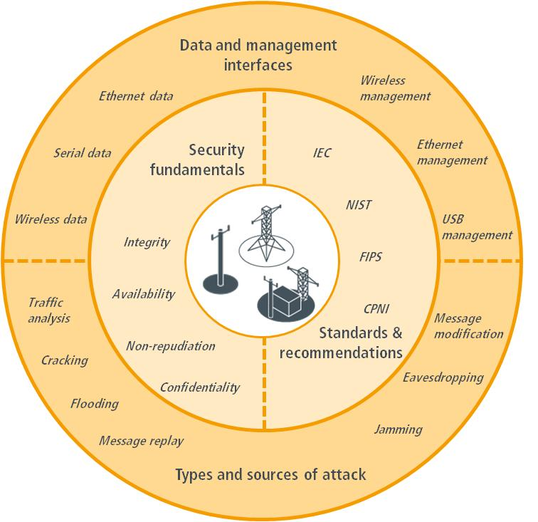





Aprisa SR security – key 4RF differentiator
Specific references include IEC/TR 62443 (TC65) “Industrial Communications Networks – Network and System Security”, IEC/TS 62351 (TC57) “Power System Control and Associated Communications – Data and Communication Security”, and IEEE P1711/P1689/P1685.

Slide 8

Aprisa SR security details designed in from the start
A comprehensive and in-depth approach to cyber security from the very start is the best way to protect a network. The Aprisa SR takes into account of four key factors:
  Security fundamentals: integrity, availability, confidentiality and non-repudiation
  Sources and types of attack: communications and control systems are subjected to attack from many sources, internal and external, malicious and accidental
  Types of traffic and interfaces, both management and data, that could be compromised
  Security standards and recommendations: industry best practice

Slide 9
Key considerations – integrity and availability
A reliable network must be designed around maintaining integrity and availability.
What is integrity and why is it important?
  Integrity is preventing the unauthorised modification of information
  The communications network must ensure that a control message received by a remote asset is the same message that was originally sent to that asset
  A ‘halt’ message that has been changed to a ‘run’ message may have catastrophic consequences
What is availability and why is it important?
  Availability is preventing the denial of a service
  If a control message is sent to a remote asset there must be an assurance that that message actually arrives at the remote asset
  A ‘halt’ message that never arrives may also have catastrophic consequences
CBC MAC authentication and the RF design of the Aprisa SR combined with powerful FEC and CRC mechanisms address these goals.

Slide 10
Key considerations – confidentiality and non-repudiation
A secure network must be designed around maintaining confidentiality and
non-repudiation.
What is confidentiality and how it is achieved?
  Confidentiality is preventing the unauthorised access to information
  Encryption is used to reduce information leakage as far as possible to potential attackers: the key can be securely changed by over the air rekeying (OTAR)
What is non-repudiation and how is it achieved?
  Non-repudiation is preventing the denial of an action
  Data authentication ensures that data and commands cannot be refuted, preventing replay and man-in-the-middle attacks
These functions are implemented in the Aprisa SR through the use of robust and recognised cryptographic algorithms and techniques based on the AES standard, using block ciphers and 256 bit keys and the NIST specified CBC MAC method of authentication.

Slide 11
Security technical summary
The Aprisa SR security incorporates a number of key technical factors:
  Advanced Encryption Algorithm (AES), based on the Rijndael proposal as
  specified in FIPS PUB 197, configurable as 128, 192 or 256 bit encryption,
  with OTAR, optionally applied to all management and user data
  Cipher Block Chaining Message Authentication Code (CBC-MAC) specified
  in NIST SP 800-38C ensures data is from an authorised source
  Use of licensed frequency bands offers regulatory protection against
  interference from other users or unauthorised interference – while this does
  not stop jamming from occurring, enforcement measures are provided by the government licensing agency unlike unlicensed systems where there is no protection
  The use of a high performance receiver design and the choice of modulation and coding improves interference performance
  Corrected Block TEA (XXTEA) in CBC mode for encrypted software upgrades from USB memory sticks prevents a hacked version of Aprisa SR software being injected
  Data / management IP port segregation avoids management masquerade

Slide 12
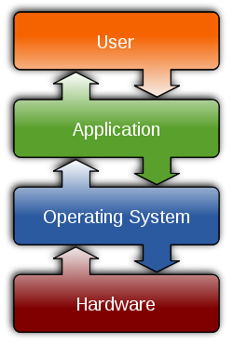
Internal operating system security summary
The Aprisa SR operating system security measures comprise:
  No output is displayed during boot sequence – together with closing ports during system start-up, this prevents interruption of the start-up sequence and the ability to compromise operation
  No user access to the radio’s internal file system – the core operating system of the Aprisa SR is not accessible to, or programmable by, the end-user thus ensuring the core functionality of the radio cannot be compromised
  Telnet port block – restricting Telnet access prevents unauthorised access to the management functions of the radio
  ICMP block – blocking ICMP data protects the network should it become subject to a denial of service attack
  FTP block – limiting access to file transfer functionality prevents unauthorised users transferring and uploading malicious files over the communications network

Slide 13

Management security summary
Authorisation levels means that end user accessible parameters are limited. Limiting the number of personnel who can change functional settings reduces the potential of inadvertent change or malicious tampering; options are view-only, technician, engineer and admin, all assigned appropriate privileges.
  Basic authentication with user name and password ensures that the end user must be approved by the system administrator before gaining access to the radio.
A session cookie over HTTPS on a web interface provides a secure connection to the SuperVisor web browser management application:
  HTTPS Authentication is TLS 1.0 (SSL 3.1) IETF RFC 2246 January 1999
  Session cookies expire when the end user’s browser is closed, for increased user authentication
  Automatic logout – in the event of a user failing to end their management session, SuperVisor will automatically terminate the session, after a pre-determined time, and prevent unauthorised access to the radio

Slide 14
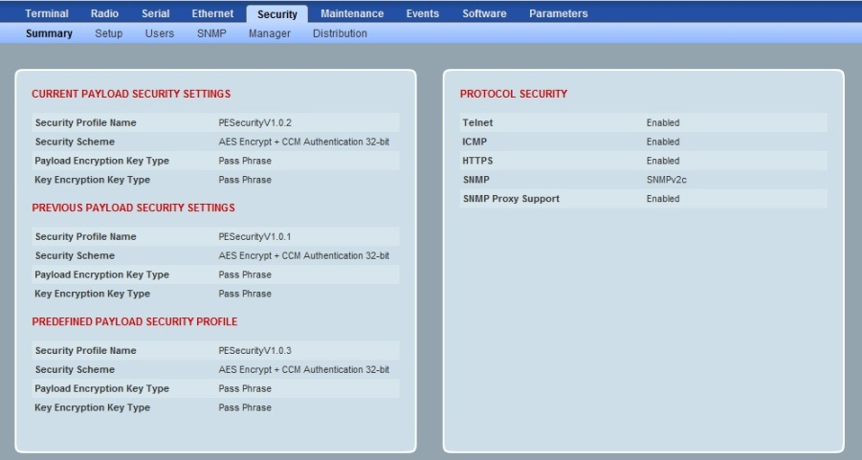
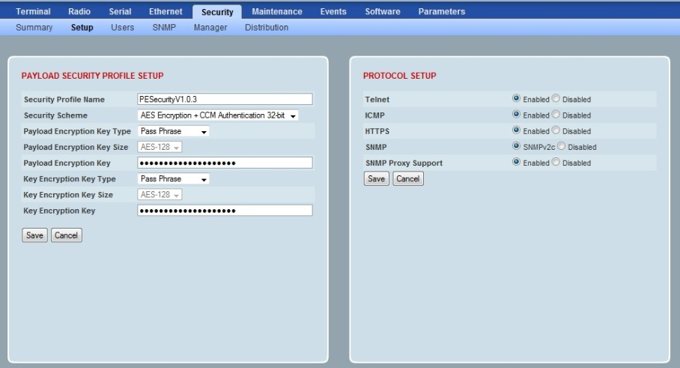
Security key management summary
  Changing encryption keys at regular intervals improves the security of the network
  Secure key management provides the ability to change the encryption keys remotely throughout the network
  Managed through menu items in SuperVisor
  ‘Manager’ page for key management
  ‘Distribution’ page for key distribution
  Follows the same process as OTA software upgrades

Slide 15

Security also extends to site security
Site security has become a major issue in the post 9/11 world and with record metal prices. Targets include critical infrastructure, electrical substations, cellular towers, land lines, railroads, water supplies:
  August 2010: thieves took two kilometres of copper cable from the UK Whitelee wind farm, shutting down two 110 m high turbines
  September 2010: thieves shut down 31 turbines at the Tararua New Zealand wind farm
The FBI states that copper theft impacts the US critical infrastructure security and recommends countermeasures, including technological security measures (alarms):
  The remote nature of these events often means radio is the only method available for automatically reporting intrusions
  The Aprisa SR can be used to bring back alarm sensor indications to a central SCADA or security monitoring site, avoiding the need for outsourced alarm system providers
Copper: a key target for theft

Slide 16
Security messaging summary
Just a decade ago there was little interest in SCADA security. In the 21st century the world changed. 4RF has recognised this in the design of the Aprisa SR through the implementation of the powerful security features.
Other SCADA radios have encryption but the care and attention to issues such as authentication, key encryption keys and remote key change, USB file encryption, and the other components of the 4RF defence in depth 360 degree approach make it unique.
The security measures and future-proof design built into every Aprisa SR provide insurance as government infrastructure security recommendations turn to regulations.

Slide 17
FAQs
FAQ | Security
Q. | Other radios have AES: isn’t that enough?
A. | No – encryption prevents eavesdropping only while the key is safe and, in the SCADA world, a ‘replay attack’ is possible without keys if authentication is not used.
Q. | Do the security measures reduce the throughput of the Aprisa SR?
A. | Security functionality does create a small but necessary overhead to the transmitted data – this can be modelled with the 4RF ChannelScape tool.
Q. | Security seems complicated: do I need to understand all this?
A. | It is not necessary to understand the implementation detail but it is necessary to understand security principles and be aware of the critical nature of security today.
Q. | Can 4RF provide more information on security to customers?
A. | Yes, this presentation is just an overview – 4RF is happy to engage with customers and address security questions.

